Slide 1
Welcome to 2nd Grade!

Slide 2
ENVISION
Math lesson handouts will come home. This will inform you of the topics and lessons that your child is learning each day.
The Reteaching handout will be a review of each topic. It will have the date of the test written on it and it will be a great way to help your child study.

Slide 3
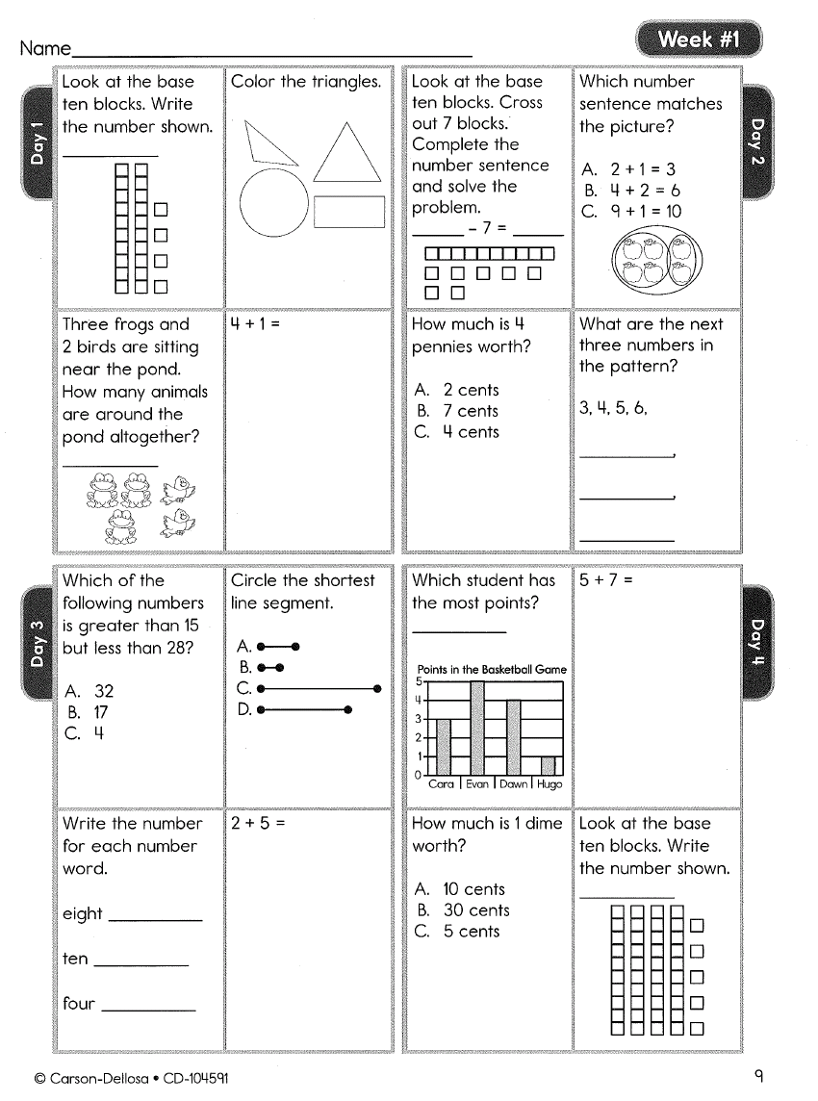
MATH 4 TODAY
In order to help us introduce certain math skills that are not taught until the end of the year, we will be reviewing these skills through Math 4 Today.
A completed review sheet will come home no later than Wednesday. Please use this to study for their test on Friday.

Slide 4
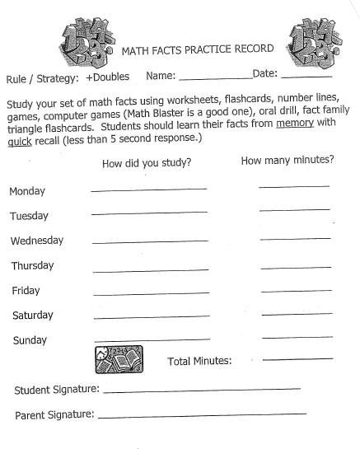
MATH FACT HOMEWORK
A study log will come home every Friday.
Please fill out the log, sign it, and have your
child return it the following Friday.
How much time is your child expected to
study their facts?
This is different for each individual child. Each child should study their math facts for the amount of time that is needed depending on how well they know their facts. Some students may need to study 10 minutes each night, some may need to study 10 minutes in one week.
Their math fact tests will be on Fridays.
The goal is that your child fluently knows all of their addition/subtraction facts up to 20 by the end of second grade.

Slide 5
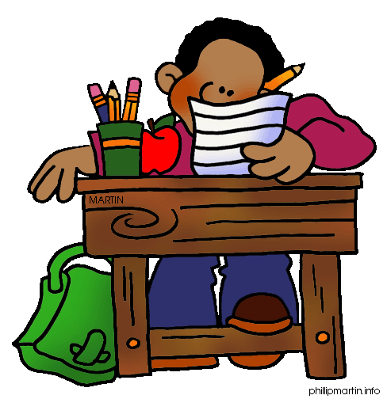
SPELLING HOMEWORK
New spelling lists will come home on Wednesdays.
Spelling tests are on the following Wednesday.
There are 2 lists… “A” List and “B” List
A List – This is the list of words from the LEAD 21 reading curriculum. It will usually focus on a particular phonics skill.
B List – This is a list of challenge words that focus on the same skill as the A List words.
It is up to parents and/or the classroom teacher to decide which list is best for your child.

Slide 6
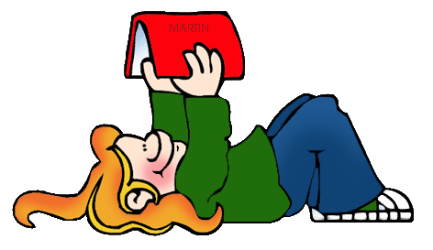
READING HOMEWORK
Your child’s reading homework is to read each night for at least 20 minutes.
This is beneficial for beginning readers and fosters good reading habits.
Listen to your child read or read aloud to your child.
Talk to your child about what they
have read/heard. Ask questions!
Remember that the only way for your child to become a better reader is to practice reading.

Slide 7
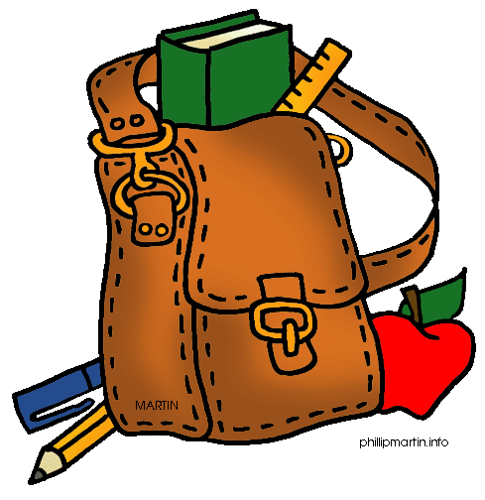
ASSIGNMENT NOTEBOOKS
Your child will write their assignments each day.
They are responsible for completing their homework and having a parent/guardian sign their assignment notebook each night.
Please do not sign unless they have completed their assignments. They will be rewarded for showing responsibility throughout the week.
Updates on your child’s behavior will also be written in the comment section of their assignment notebook.

Slide 8
BEHAVIOR PLAN
Rewards
tickets, Cougar Cash, whole class rewards
Consequences
If your child moves their stick once, it is a warning.
The second time they move their stick, they will either choose to walk 2 laps on the playground or sit out for 5 minutes.
The third time they move their stick, they will either choose to walk 4 laps on the playground or sit out for 10 minutes.

Slide 9
CONFERENCES
Dates –
Oct. 24th 4-8 PM Feb. 13th 4-8 PM
Oct. 26th 4-8 PM Feb. 15th 4-8 PM
Oct. 27th 8-4 PM Feb. 16th 8-4 PM
How to Schedule
Sign up tonight
Visit your classroom teacher’s website. Check the availability and email the teacher the best date and time

Slide 10
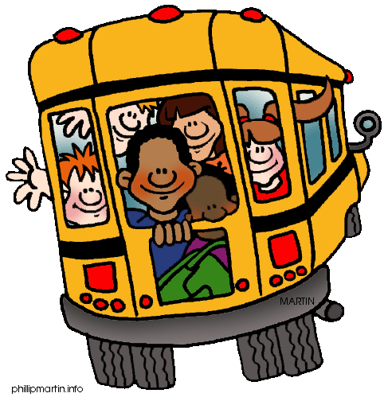
DISMISSAL
If your child will be leaving
school early…
Contact the office AND the classroom teacher before 12:20.
You can contact the teacher by email, a note, or a note in their assignment notebook.
If your child will be going home with another student…
BOTH students must have a note or they will be sent home their usual way.

Slide 11
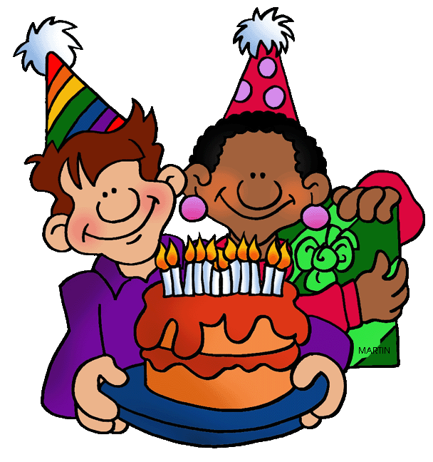
BIRTHDAYS
Birthday party invitations
These can only be distributed at school if the
entire class is invited or if all of the boys/girls in the
class are invited.
Invitations will not be passed out to students in other classes.
If you need to mail invitations and do not know the address…
Contact the office
Join PTO and you will receive a school directory
Teachers are not allowed to give out personal information
Non-food treats only

Slide 12
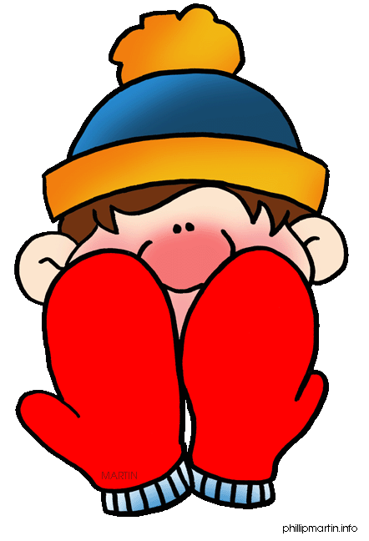
DRESS FOR THE WEATHER
Don’t trust the weatherman! It is always better to be prepared.
In fall and spring, be sure your child brings a coat to school just in case it is chilly.
In the winter, we go outside for recess everyday unless there is snow or if the windchill is below 20 degrees. Please send a coat, as well as a hat, gloves, and a scarf.

Slide 13
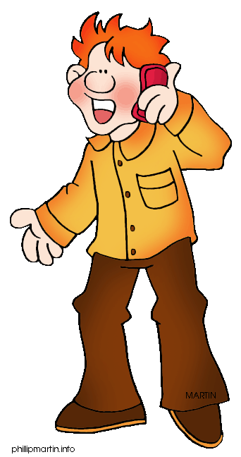
CONTACTING THE TEACHER
Times
Plan time 12:20 – 1:15 P.M.
After school until 4:00 P.M.
Ways to contact the teacher
Email
Notes in the assignment notebook
**The school is closed at 4:00 PM. No
students or parents will be able to enter
after 4:00 PM.

Slide 14
Any Questions?

